Slide 1

Fake News Authentication Using PySpark MLlib and NLP
Under the guidance of: Shiva Karthik S.
Presented by:
Anmol Ketkale
Rishabh Tripathi
Jay Sharma
Akash Nagare
Rohan Alexander

Slide 2
INTRODUCTION
The proliferation of fake news has become a major challenge in our society.
Fake news is intentionally false or misleading information that is presented as if it were real news.
Fake news can be spread through various mediums, such as social media, websites, and even traditional news outlets.
Fake news can have serious consequences, including spreading fear and panic, influencing public opinion, and damaging reputations.
In this project, we have used PySpark MLlib and Natural Language Processing (NLP) techniques to build a fake news detection system.

Slide 3
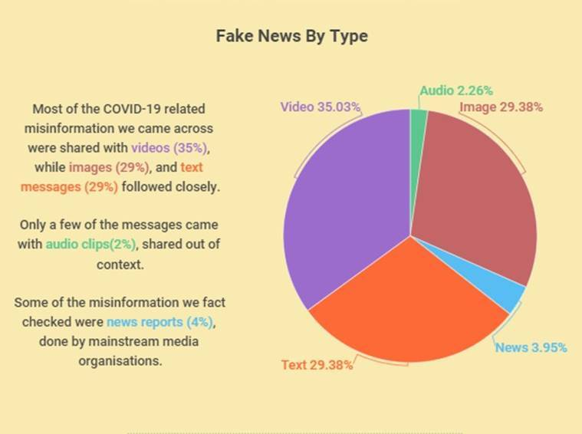
Source Photo: Indian Express

Slide 4
Flowchart of the project
Data Collection
Pre-processing of data
Feature Extraction
Model Training
Model Evaluation
Model Deployment

Slide 5
Data Collection
For training our machine learning model, data is collected from Kaggle, McIntire, Reuters, BuzzFeed Political website
We are merging two or more dataset for increasing our model efficiency
One of our dataset is taken from The Information Security and Object Technology (ISOT) Research Lab
Another dataset is a part of our ongoing research on "Fake News Prediction on Social Media Website" as a doctoral degree program of Mr. Pawan Kumar Verma and is partially supported by the ARTICONF project funded by the European Union’s Horizon research and innovation program.

Slide 6
Why PySpark MLlib
Apache Spark provides the machine learning API known as MLlib.
Spark's scalable machine learning package, MLlib, enables machine learning techniques on large datasets.
Distributed systems are compatible with it
We can do parallel processing in PySpark
It is simple to use and Scalable
We are using PySpark for pre-processing of dataset

Slide 7
Natural Language Processing
Natural Language Processing (NLP) is a field of study that focuses on the interaction between computers and human language.
Tokenization: This involves breaking up text into smaller units such as words, phrases, or sentences.
StopWordsRemover: Stopwords are words that occur frequently in text but do not carry significant meaning, such as "the", "and", and "is". In many NLP applications, it is common to remove stopwords to improve performance and accuracy of the models.

Slide 8
Feature Extraction
Feature extraction is a crucial step in many machine learning and data analysis tasks, including image recognition, natural language processing, and speech recognition.
In feature extraction, we take raw input data and transform it into a set of features that can be used to represent the data in a way that is more suitable for analysis and machine learning algorithms.
In our project we have used NLP. We took raw input string and transform it into vectors that can be used to represent the data.
We used word2vec for doing this transformation which is an advanced method to achieve this.

Slide 9
Vectorization Techniques in NLP
TF-IDF
CountVectorizer
Word2Vec

Slide 10
Word2Vec
Word2Vec: Word2Vec is a popular technique used for natural language processing (NLP) that is based on neural network models.
Word2Vec is based on the idea that words that occur in similar contexts tend to have similar meanings
The basic idea is to train a neural network on a large corpus of text to predict the probability of a word given its context (i.e., the surrounding words).

Slide 11
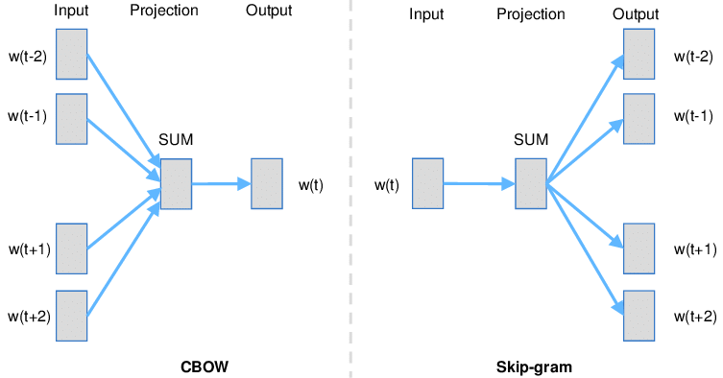

Slide 12
Machine Learning Models
Logistic Regression
Random Forest Classifier
Gradient-boosted Tree Classifier
Linear Support Vector Machine
Factorization Machines Classifier

Slide 13
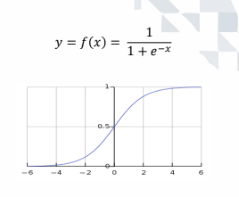
Logistic Regression
Logistic regression is a commonly used statistical method for binary classification problems.
Logistic regression is a simple and easy-to-understand algorithm, making it a good starting point for many data science projects.
Logistic regression is relatively fast to train, making it useful for large datasets and real-time applications.

Slide 14
Random Forest Classifier
Random forests are a popular machine learning algorithm used for classification, regression, and feature selection tasks.
Random forests can produce highly accurate predictions due to their ability to reduce overfitting and the ensemble nature of the algorithm.
Random forests can handle outliers due to their averaging mechanism and ability to detect relationships between features and outcomes.

Slide 15
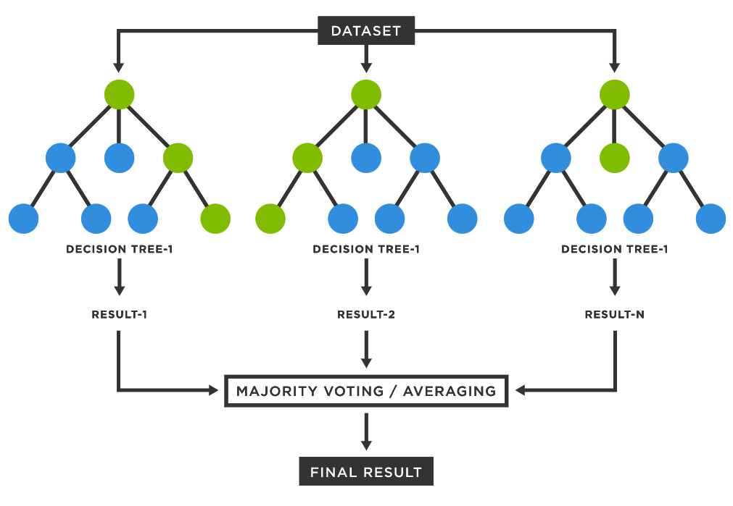

Slide 16
Gradient-boosted Tree Classifier
Gradient Boosted Trees (GBTs) are a powerful and popular machine learning algorithm used for both regression and classification tasks.
GBTs can produce highly accurate predictions, often outperforming other popular algorithms such as random forests, support vector machines, and neural networks.
Ability to handle complex relationships: GBTs can model complex nonlinear relationships between features and outcomes, making them well-suited for a wide range of problems.
Feature importance ranking: GBTs provide an estimate of feature importance, which can be useful for feature selection and understanding the underlying data.
GBTs have some limitations, such as their sensitivity to hyperparameter tuning, which can be time-consuming.

Slide 17
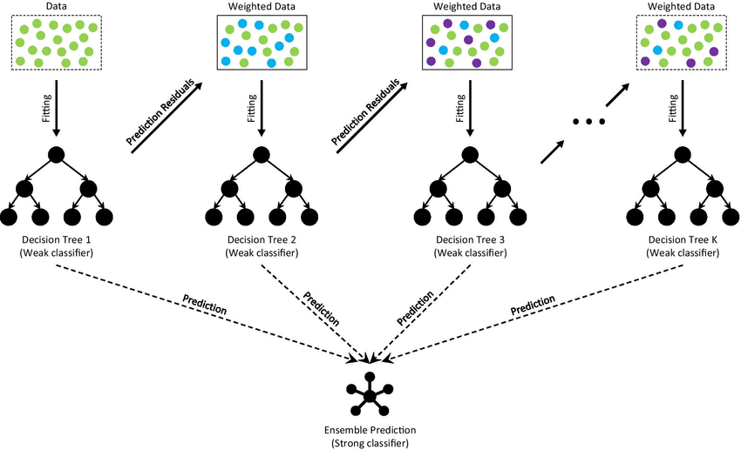

Slide 18
Linear Support Vector Machine
Linear Support Vector Machines (Linear SVMs) are a popular machine learning algorithm used for both classification and regression tasks.
Linear SVMs are particularly useful when dealing with high-dimensional data, such as text data, where the number of features can be much larger than the number of samples.
Linear SVMs are relatively robust to outliers in the data, as they focus on finding the maximum margin separating hyperplane, which tends to be less affected by outliers.
Linear SVMs can be applied to both linearly separable and non-linearly separable datasets, using techniques such as kernel tricks to transform the data into a higher-dimensional space.
Fast training times: Linear SVMs can be trained efficiently on large datasets, making them useful in many real-world applications.

Slide 19


Slide 20
Factorization Machine Classifier
Factorization machines are a type of supervised learning algorithm. They are used for classification and regression tasks.
Factorization Machines are able to estimate interactions between features even in problems with huge sparsity (like advertising and recommendation system).

Slide 21
Data Extraction
For authentication of our model we are extracting data from news websites like CNN, Times of India, Indian Express and ABC News.
For data extraction we are using Python library Beautifulsoup.
Further we can built new models on this extracted data.

Slide 22
Ways to Extract Data
Using web scraping libraries: There are several libraries available in various programming languages, such as Python's Beautiful Soup, Scrapy, and Selenium, that can be used to scrape web pages. These libraries provide functions and methods to parse HTML or XML code and extract relevant information.
APIs: Many websites offer APIs that allow developers to access their data in a structured format. APIs are typically easier to use and more reliable than web scraping, as they are designed to provide access to specific data points. However, not all websites offer APIs, and some may charge fees for access.

Slide 23
Extraction Process
In Our Project we scrapped data using Beautiful soup.
Beautiful Soup is a Python library that is commonly used for web scraping purposes. It allows you to parse HTML and XML documents and extract data from them in a structured way.
Beautiful Soup is widely used for a variety of web scraping tasks, such as extracting data from online news articles, scraping product information from e-commerce websites, and collecting data from social media platforms. Its flexibility and ease of use make it a popular choice for developers and data scientists working with web data.
Request python library used to convert url into string.

Slide 24
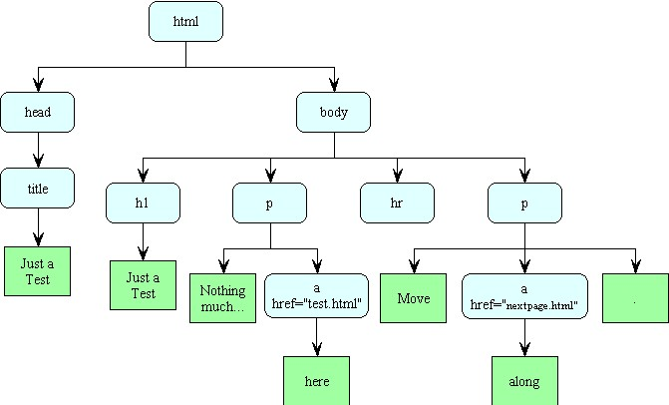
HTML Tree

Slide 25
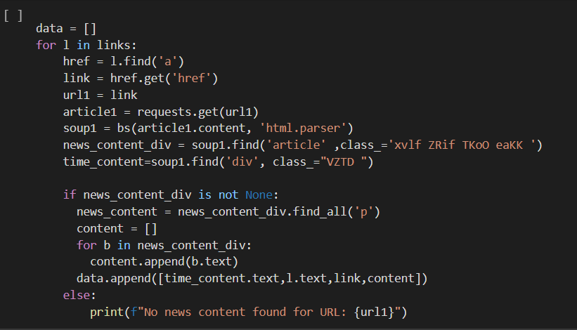
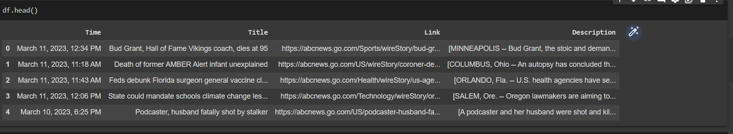

Slide 26
Serialization and Deserialization
Serialization and deserialization are used to save and load machine learning models and their associated data.
This allows trained models to be reused, shared between different applications, and deployed on different machines.
Pickle is a Python module used for serializing and deserializing Python objects
PySpark by default have serializing and deserializing function for example save() and load() functions in the MLlib library can be used to save and load machine learning models and associated metadata in a serialized format.

Slide 27
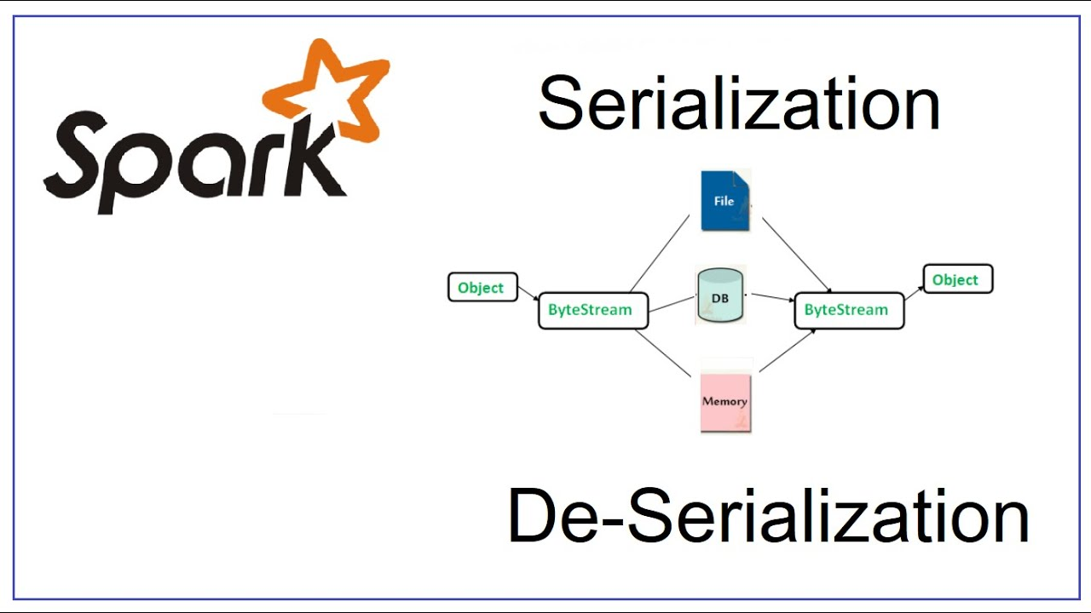

Slide 28
Ways to Deploy Model
API
Website
Cloud (Plan to use Streamlit Cloud).

Slide 29
Deployment: Streamlit
Streamlit is a popular open-source Python library used for building interactive data science web applications.
It provides an easy-to-use interface that allows you to create custom web applications without requiring extensive web development knowledge or skills.
We can write text, headers, take input from users upload images, use matplotlib for displaying different types of plots
We can use stream-lottie to integrate animations in web application

Slide 30

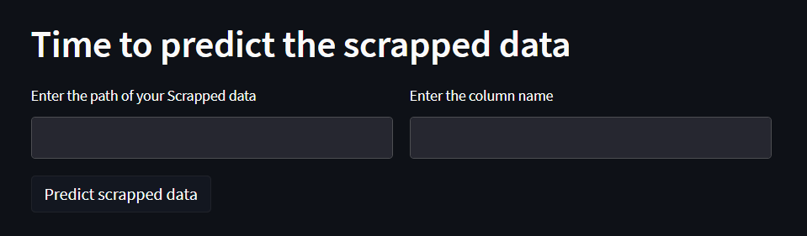
User Inputs
Data input from the user is going to be in two formats:
News Article Feed (String)
Scrapped Data from News Website (DataFrame)

Slide 31
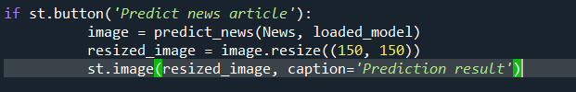
Buttons
Streamlit buttons triggers a specific actions

Slide 32
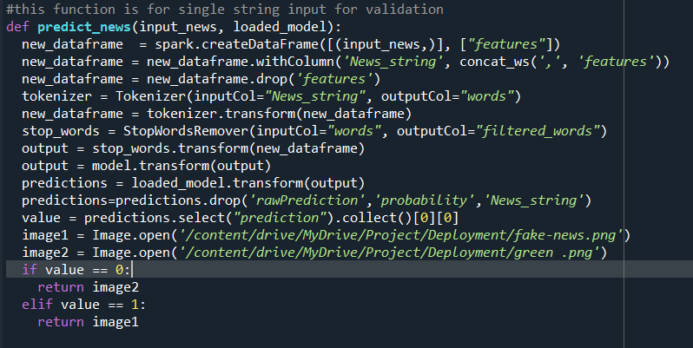
News Article Feed (String)

Slide 33
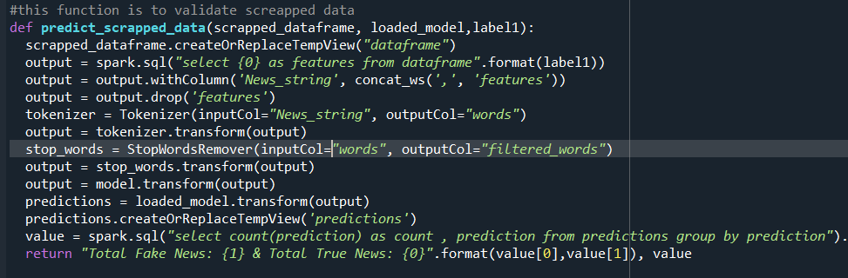
2. Scrapped Data from News Website (DataFrame)

Slide 34
Future Enhancements
Incorporate more data sources: In order to improve the accuracy of fake news detection models, it may be beneficial to incorporate a wider variety of data sources. For example, social media data and user engagement metrics could be used to better understand how news articles are being shared and interacted with.
Experimenting with different feature engineering techniques, such as topic modeling or sentiment analysis, could improve the accuracy of fake news detection models.

Slide 35
Limitations
Machine learning models require large amounts of high-quality training data to be effective. However, in the case of fake news detection, it can be difficult to obtain large datasets of accurately labeled news articles.
If the training data used to train PySpark MLlib models is biased, the resulting models may also be biased. This can be particularly problematic in the case of fake news detection, where biased training data could result in inaccurate or incomplete classifications.

Slide 36
Conclusion
In conclusion, fake news detection is a complex task that requires the integration of various techniques such as natural language processing, machine learning, and data analytics.
The detection of fake news is crucial in today's society to ensure that individuals receive accurate information and prevent the spread of misinformation.
Overall, the development of an accurate fake news detection system is a critical step towards creating a more informed and trustworthy media landscape.

Slide 37
Thank-You

